Slide 1
SB 794 and Sonoma County
Samuel Wallis
Community Alert & Warning Manager

Slide 2
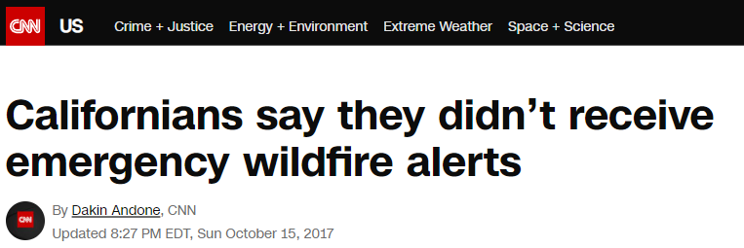
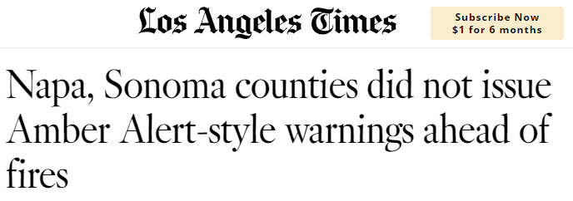
Background
SoCo Backstory
2017 Fires
Notes:
<SAM>
Backstory:
Disasters were generally flooding incidents with forecasted time
Then the 2017 Fires happened
Nothing of that magnitude before
Confusion and chaos – alerts sent after neighborhoods already were burning
Multiple Alert originators not necessarily coordinated
No WEAs issued
Loss of confidence in alert and warning, scapegoating

Slide 4
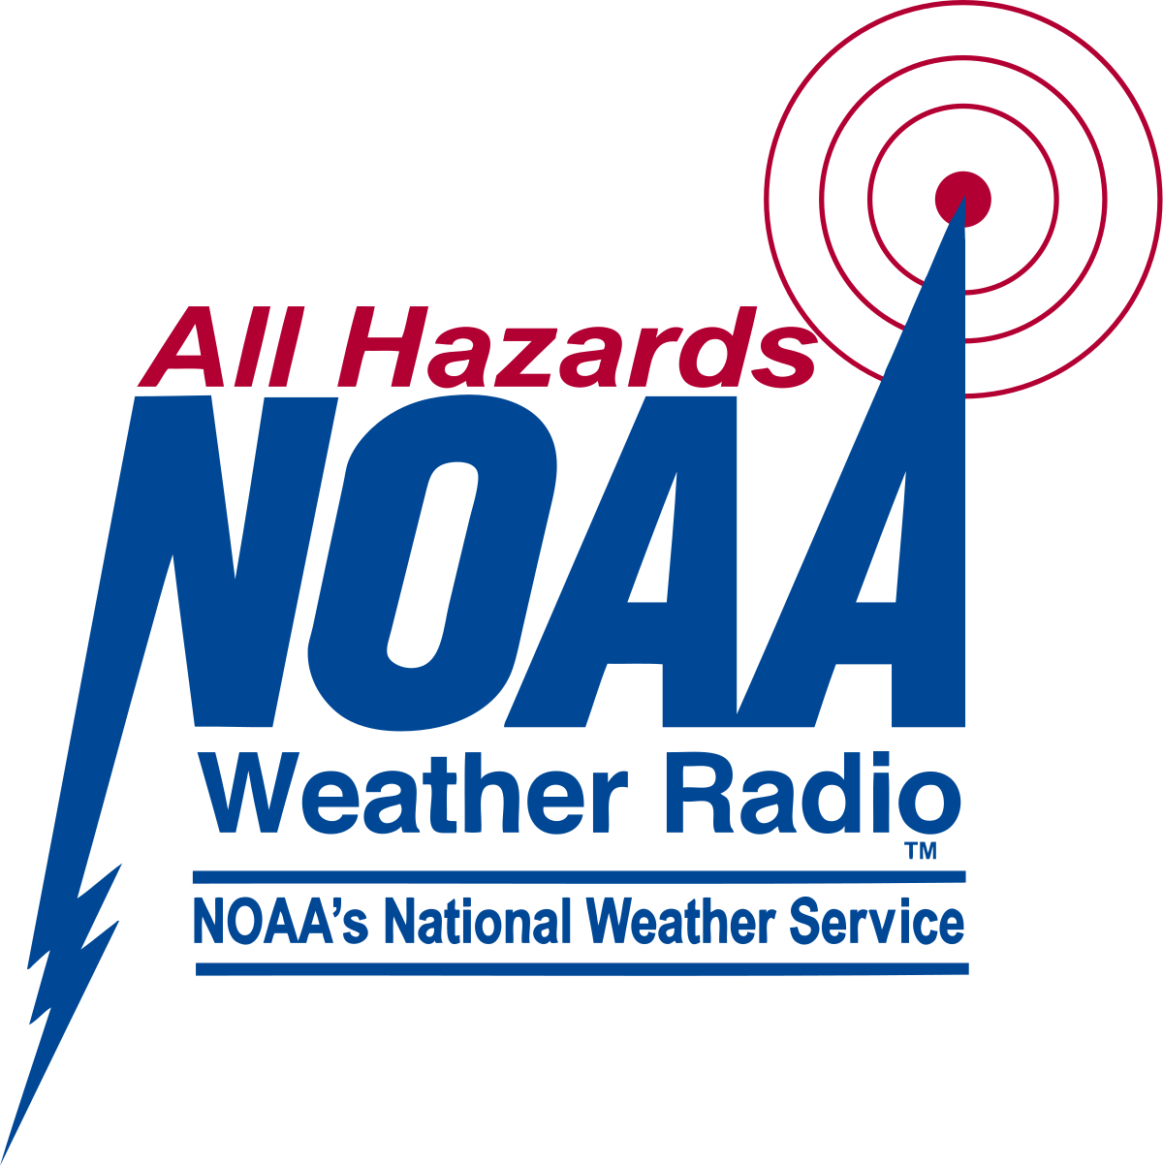
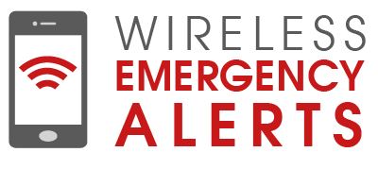
iPAWS
Wireless Emergency Alerts
Emergency Alert System
NOAA Weather Radios/NWEM

Slide 5
Comparing Data
Phone numbers targeted:
2017: 7,967
Today: 25,256

Slide 6
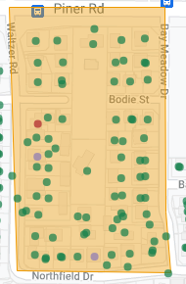
Comparing Data
City area
E911 Dataset – 14 contacts
E911/Comcast/local utility & PG&E - 131

Slide 7
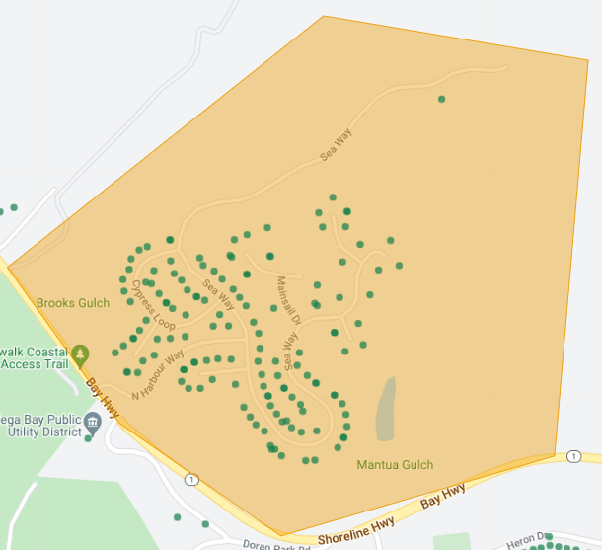
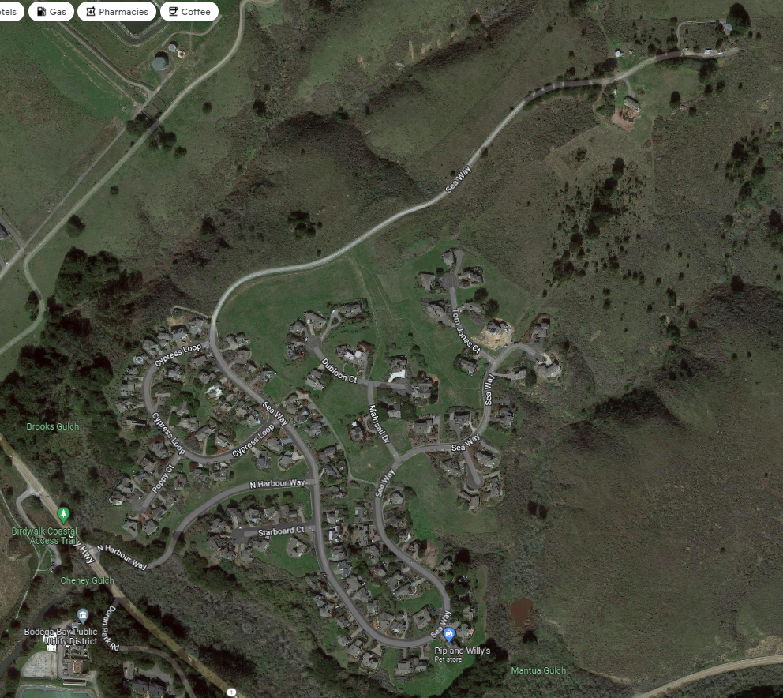
Comparing Data
Unincorporated coastal area
E911 Dataset – 28 contacts
Comcast (VoIP) & PG&E – 176
Notes:
JORGE

Slide 8
Questions
Samuel Wallis
Community Alert & Warning Manager

Slide 9
The Challenge of Opt-In Registration
small # of reach
large % rate of failure
How old is your data?

